Slide 1

1910 Census Data Analysis with Hadoop

Slide 2
Use Case
Population Densities/Growth
Gender Distribution
Religion
Field of Work

Slide 3
Workflow
2GB+ XML
200MB CSV
MRJob/Spark/MapReduce
Visualize

Slide 4
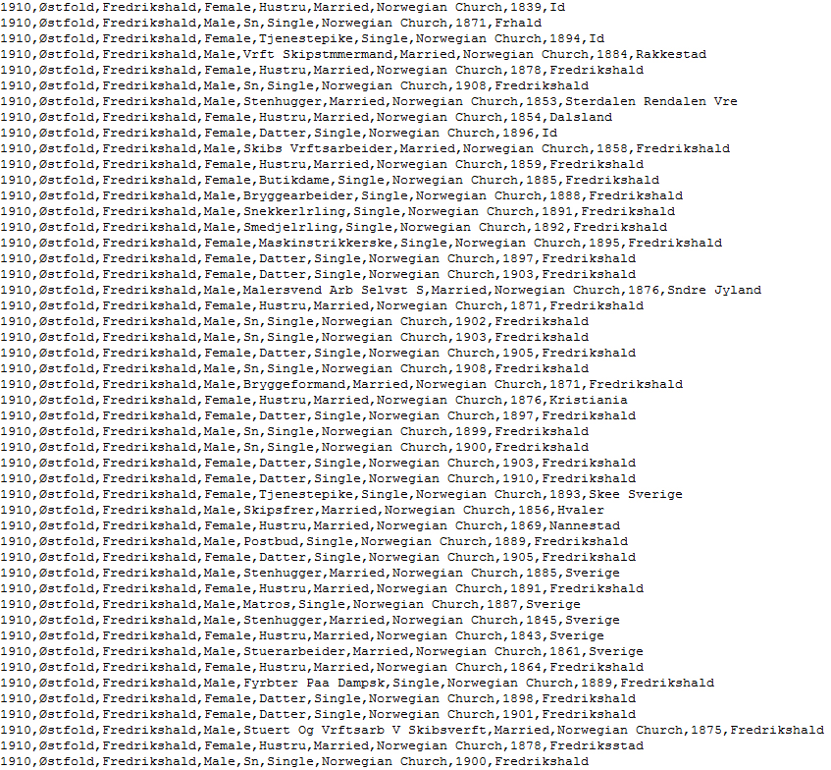
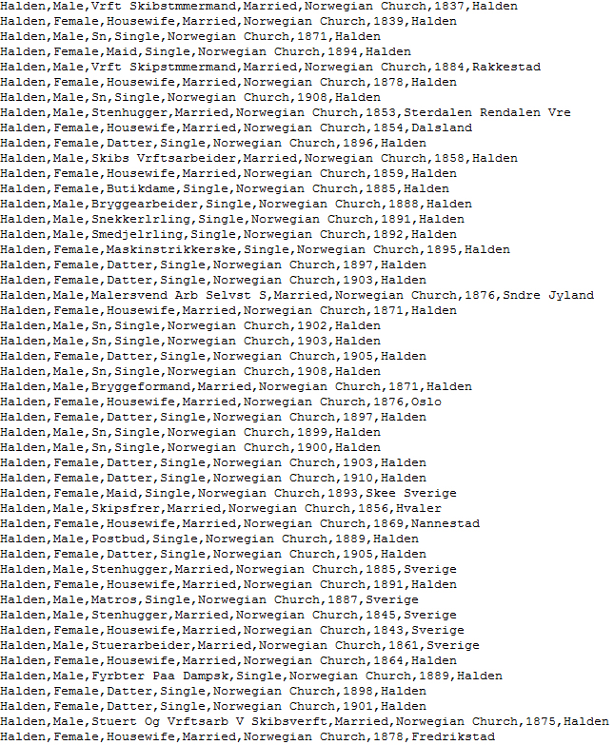
Dataset
Preprocessing

Slide 5
Visualization

Slide 6
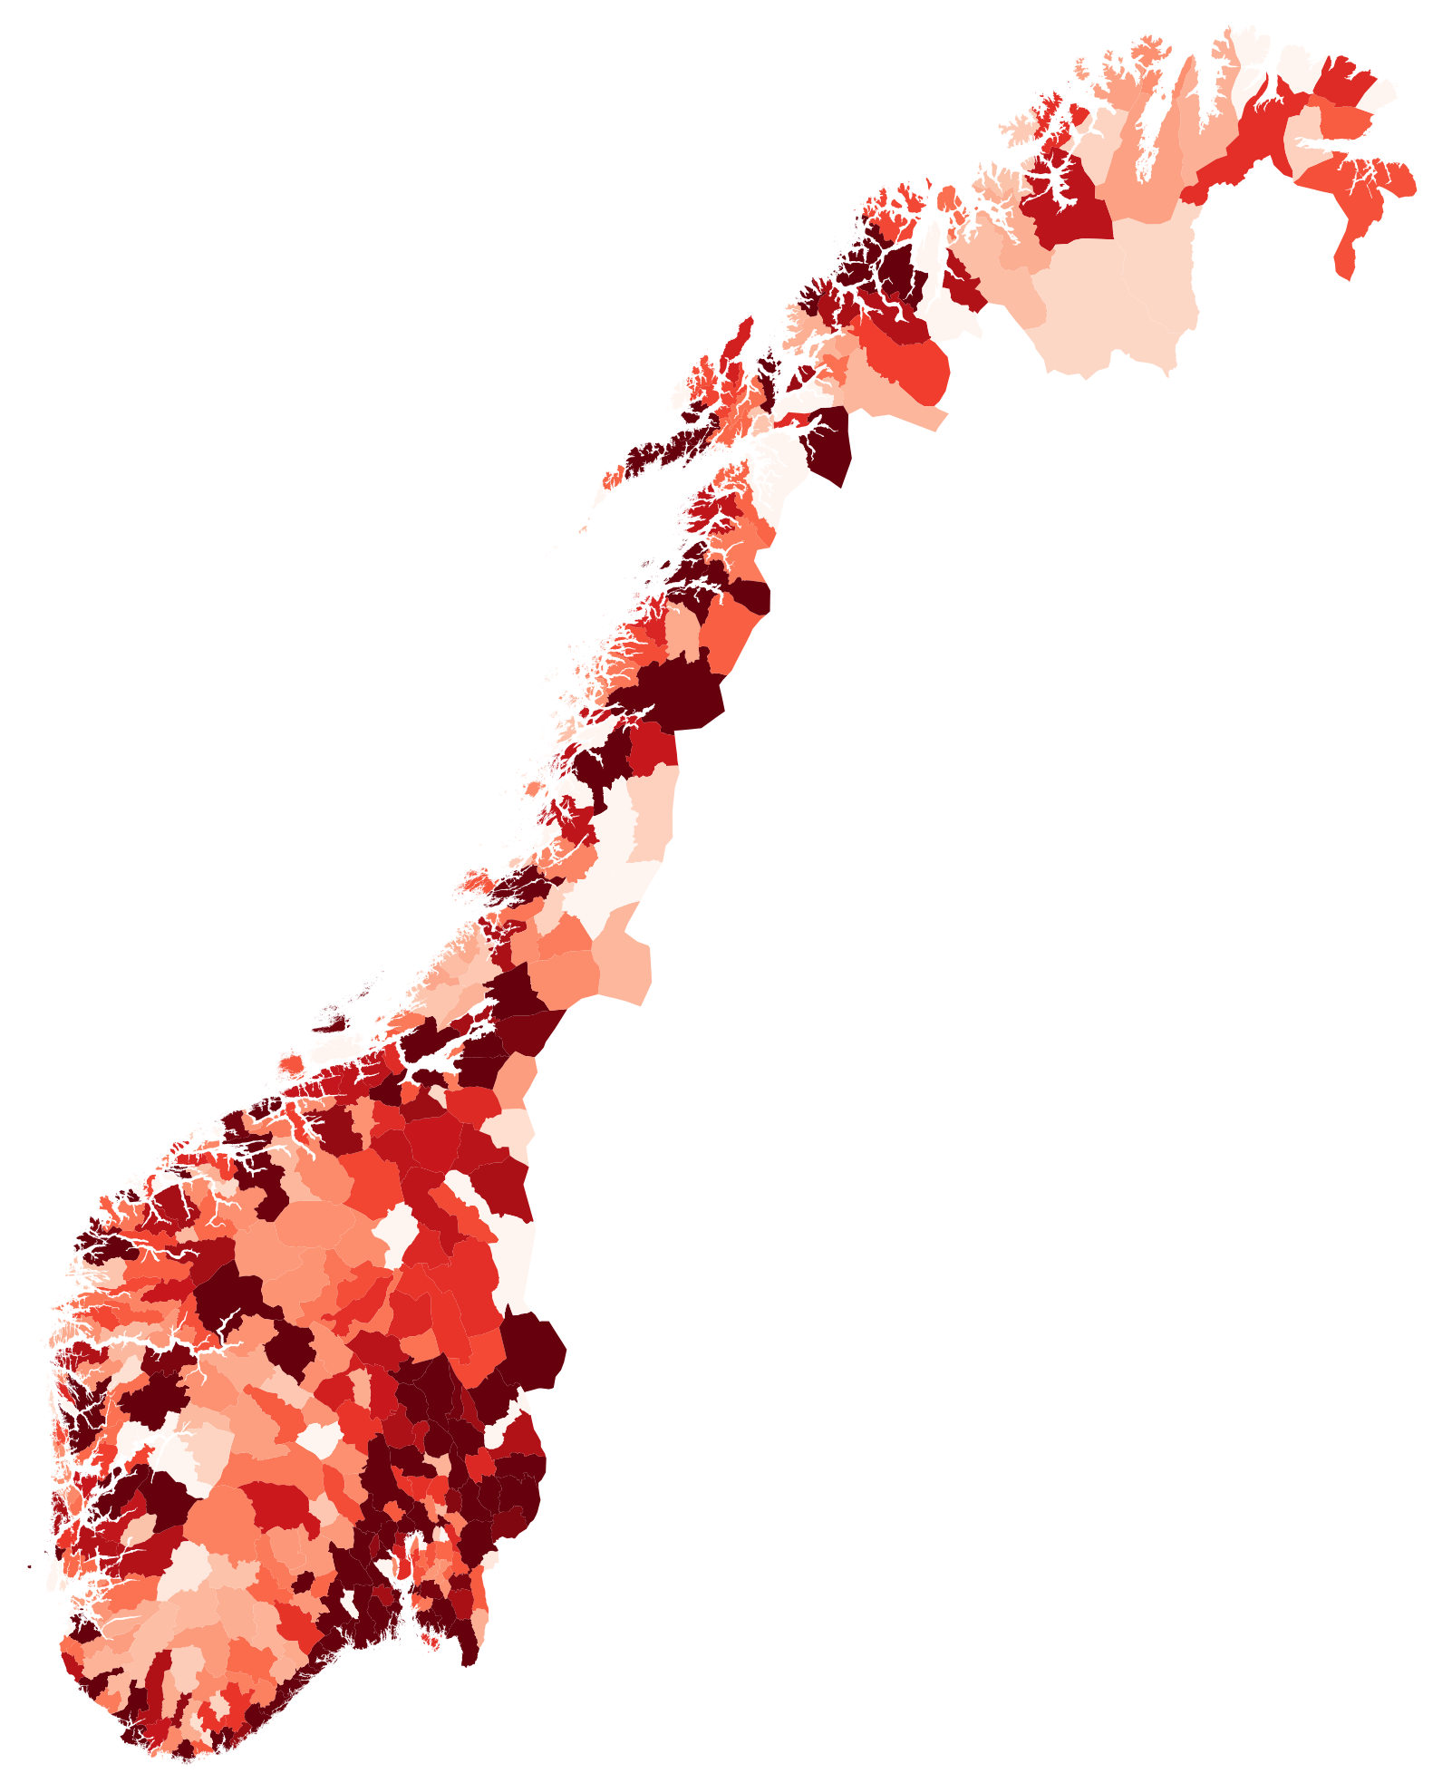
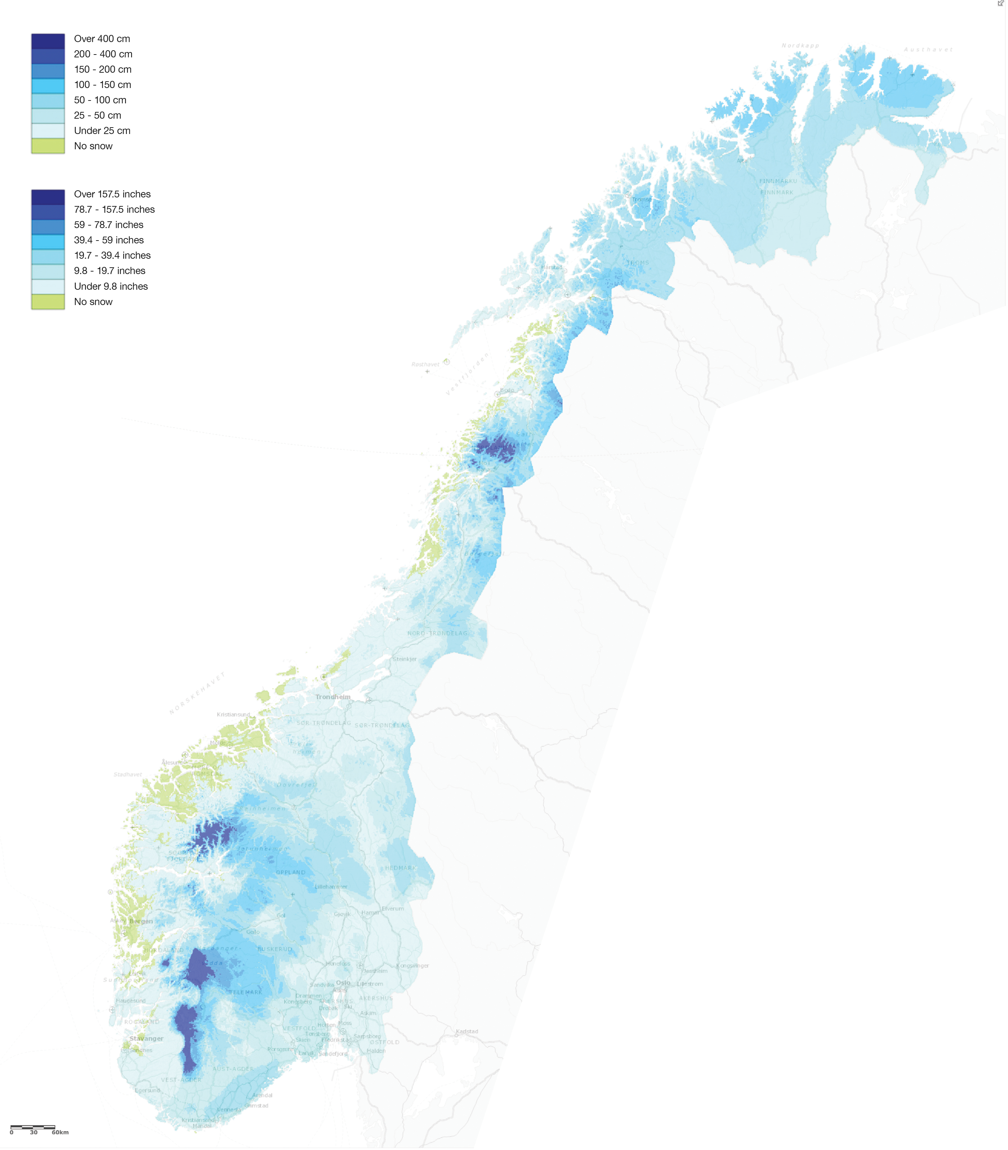
Registered Births from 1800 to 1910
Population Density in 1910
Snow Fall Ratio

Slide 7
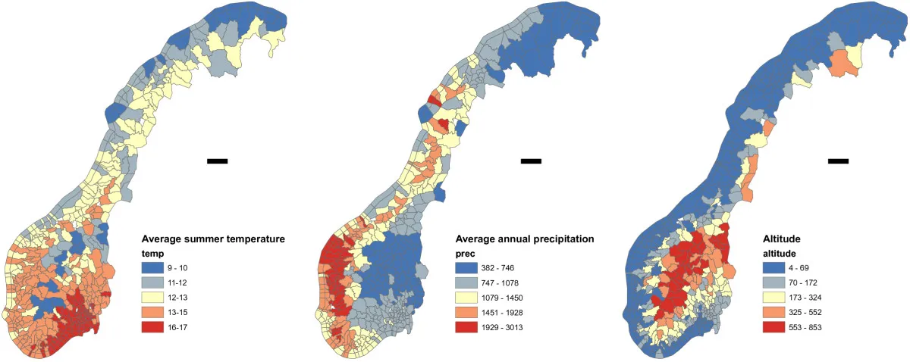
Climate of Norway

Slide 8
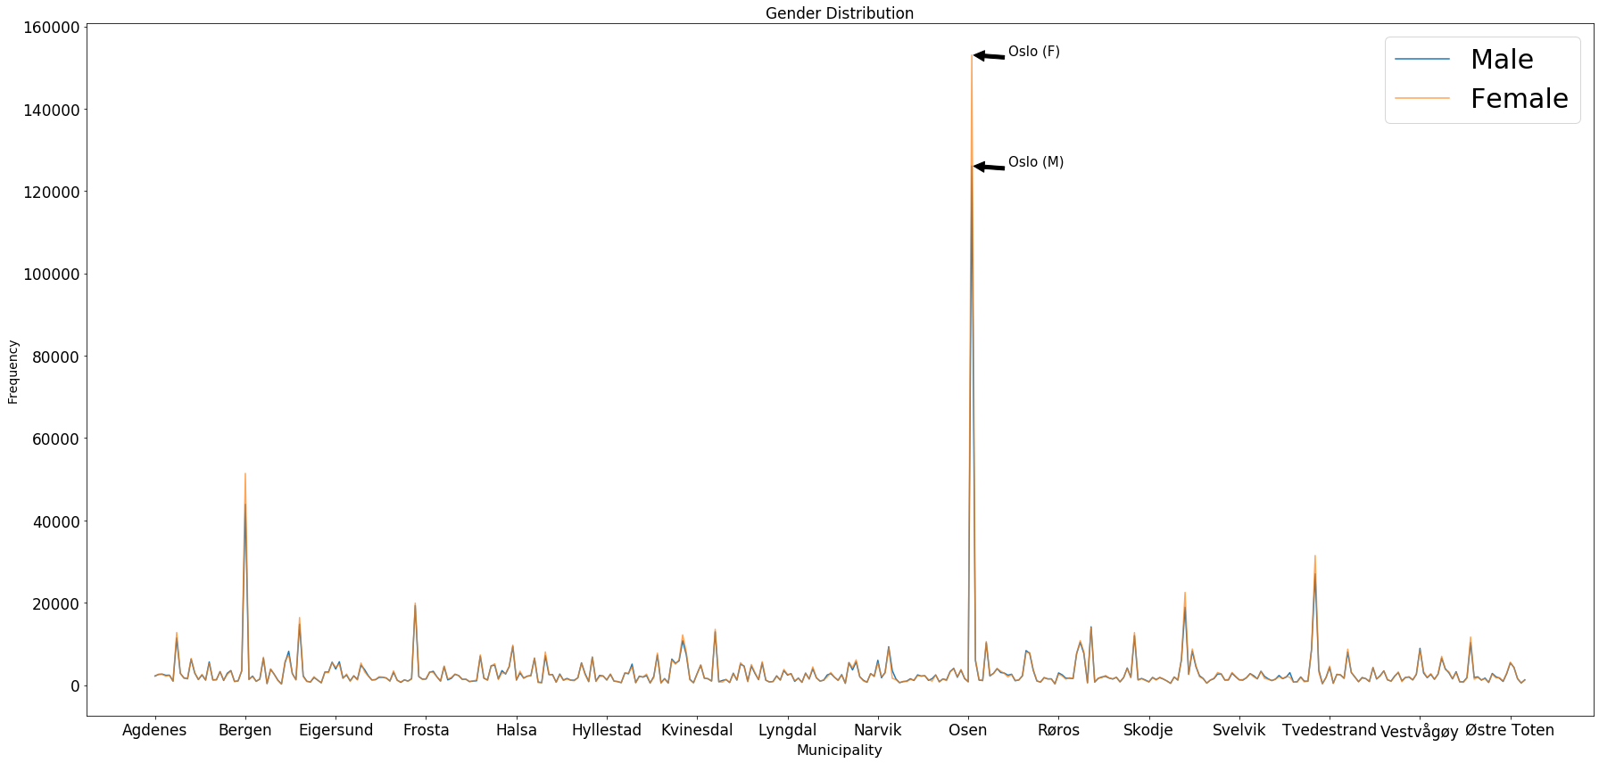

Slide 9
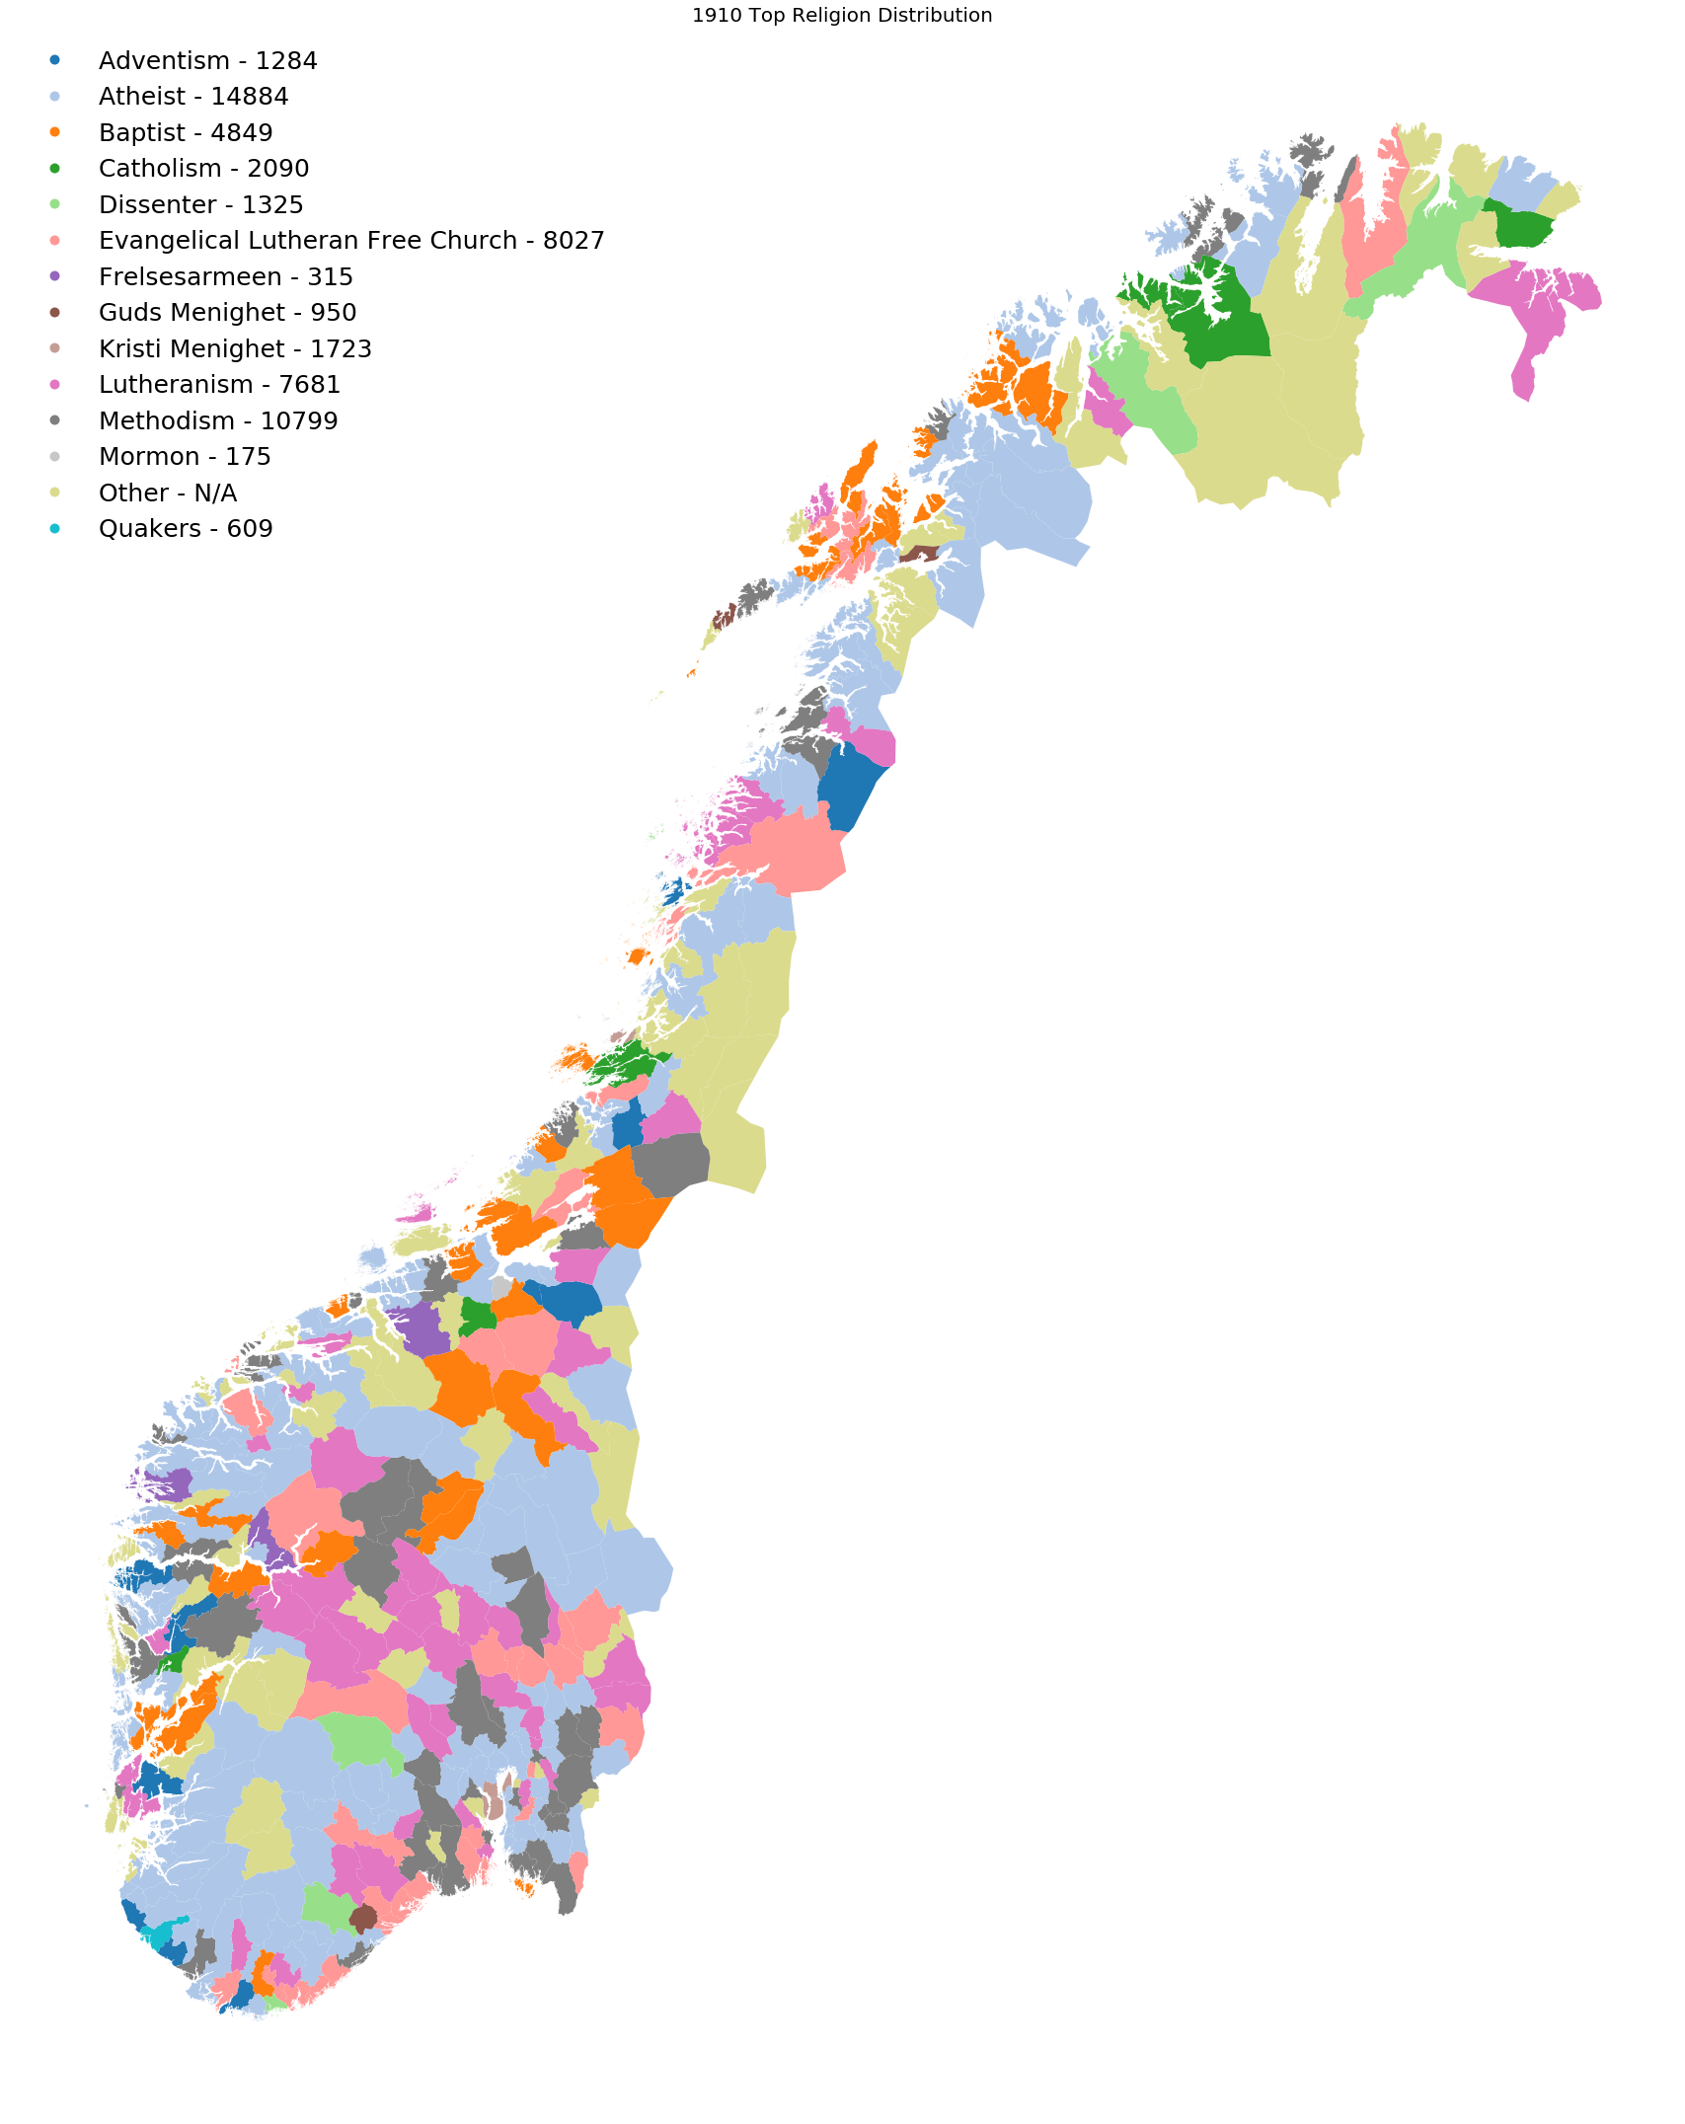
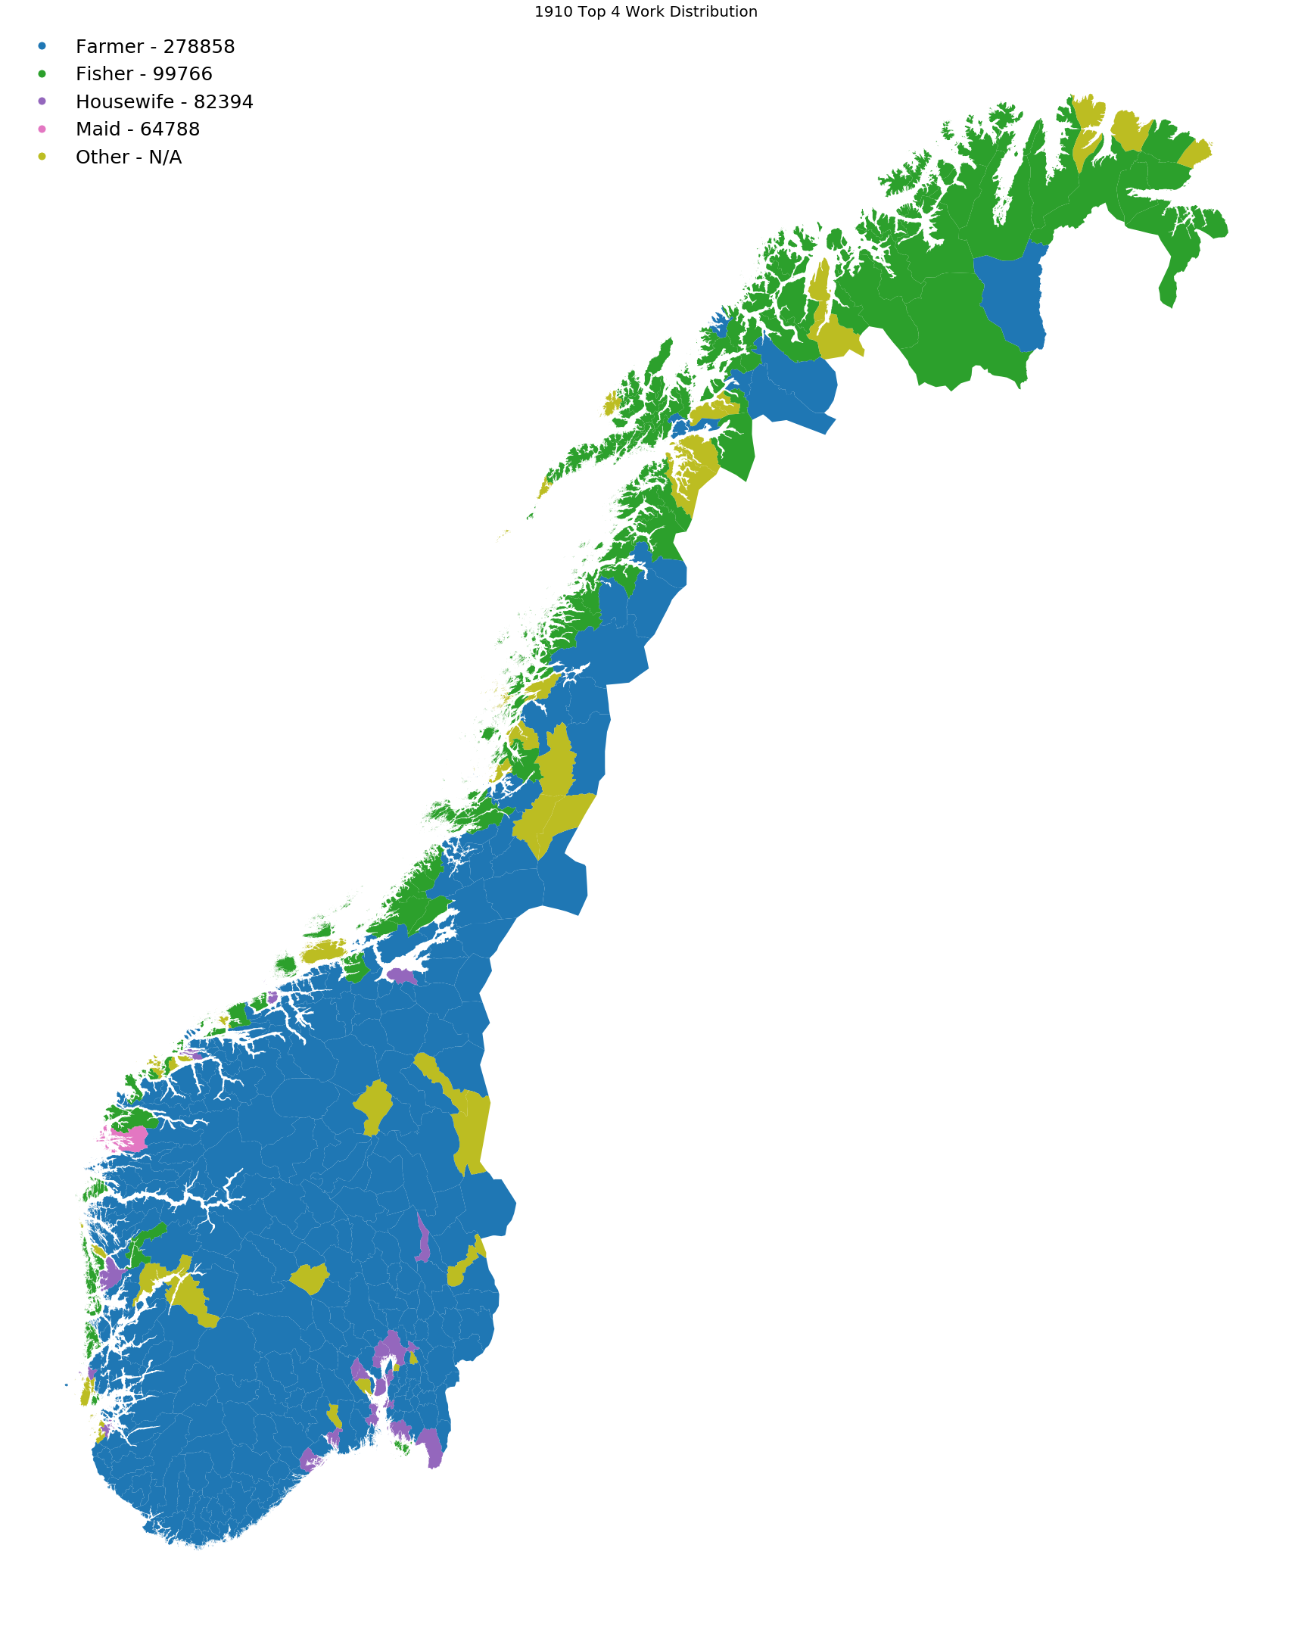

Slide 10

Thank You!
https://www.reddit.com/r/dataisbeautiful/comments/1w9rbk/current_snow_depth_in_norway/
https://bmcpublichealth.biomedcentral.com/articles/10.1186/1471-2458-13-530/figures/2
References

